Slide 1
FTE Recalibration
Kendra Jahnke
June 2018

Slide 2
Overview
When is FTE Reported?
When is FTE recalibrated?
Recalibration Basics
Recalibration to 1.0
Capped at 0.5
Exceptions to Recalibration - DJJ/McKay
Shared FTE
FTE Reports
Reported FTE
Recalibrated FTE
NEW Report – DJJ FTE Data Quality Report (F71513)
Data Quality Issues and Reminders

Slide 3
Reporting FTE
School districts should report all FTE enrollment regardless of the 1.0 FTE cap in Surveys 1, 2, 3, & 4.
Survey 1
Survey Week: July 9-13, 2018
Due Date: July 27, 2018
State Processing: July 23-September 14, 2018
Final Update/Amendment: September 30, 2018
Survey 2
Survey Week: October 8-12, 2018
Due Date: October 19, 2018
State Processing: October 15-November 2, 2018
Final Update/Amendment: December 15, 2018
Survey 3
Survey Week: February 4-8, 2019
Due Date: February 15, 2019
State Processing: February 11-March 1, 2019
Final Update/Amendment: April 15, 2019
Survey 4
Survey Week: June 10-14, 2019
Due Date: July 5, 2019
State Processing: June 24-July 12, 2019
Final Update/Amendment: August 15, 2019

Slide 4
Reporting FTE
Student Additional Funding FTE is reported in Survey 5.
Survey 5
Due Date: July 26, 2019
State Processing: July 22 – August 23, 2019
Final Update/Amendment Date: October 31, 2019

Slide 5
Reporting FTE
Alternate Survey Week
(Rule 6A-1.0451(2), F.A.C. )
Prior to the scheduled survey week, a district may request an alternate FTE survey week (within 9 weeks of the original survey) if enrollment is expected to fluctuate due to reasons beyond the district’s control such as natural disasters, agricultural migration, civil disturbances etc.
The alternate survey date must be established by the Commissioner prior to conducting the scheduled statewide survey. If the Commissioner of Education approves an alternate survey period, the letter of response from the DOE will include specific directions for confirmation of alternate survey results.
To be considered, a district must expect a potential enrollment change of greater than 5% for the entire district or 25% for a specific school.
If approved, the district must still conduct the regular survey.
Prior to submitting the alternate survey format records, the district will confirm with the Office of Finance and Operations that the alternate survey student membership has met the above thresholds when compared to the original survey week.
Once it is determined that the threshold variance in membership has been met when compared to the original survey week membership count, PK-12 Education Information Services will notify the district when the state student database is prepared to receive the alternate survey data. At that time the district will be advised of a limited period when updates may be submitted for the alternate survey.
Batch processing will take place after all format files have been transmitted for the alternate survey. Once these files have been processed, please follow standard protocol for edit error resolution and update file formats until all edit errors are resolved.
After all files for the alternate survey have been transmitted, final determination of variance in student membership meeting the above thresholds will be made by the Office of Finance and Operations.

Slide 6
When is FTE Recalibrated?
Calculation | When | Data Source
Conference Report | Legislative Session | Survey 1 – Projection Survey 4 – Projection Survey 2 – Projection Survey 5 – Prior Year Est. Survey 3 – Projection
2nd Calculation | July – Upon receipt of Tax Roll | Survey 1 – Projection Survey 4 – Projection Survey 2 – Projection Survey 5 – Prior Year Est. Survey 3 – Projection
3rd Calculation | Upon receipt of Survey 2 | Survey 1 – Actual Survey 4 – Estimate Survey 2 – Actual Survey 5 – Prior Year Act. Survey 3 – Estimate
4th Calculation | Upon receipt of Survey 3 | Survey 1 – Actual Survey 4 – Estimate Survey 2 – Actual Survey 5 – Prior Year Act. Survey 3 – Actual
Final Calculation | After Final Update of Survey 4 | Survey 1 – Actual Survey 4 – Actual Survey 2 – Actual Survey 5 – Prior Year Act. Survey 3 – Actual

Slide 7
Recalibration Basics
Recalibration to 1.0 FTE
1011.61(4), F.S. requires that all student Full-Time Equivalent (FTE) enrollment be capped at 1.0 FTE, except for FTE reported by Department of Juvenile Justice (DJJ) students beyond the 180-day school year and FTE related to the John M. McKay Scholarships for Students with Disabilities Program.
School districts should report all FTE enrollment regardless of the 1.0 FTE cap.
Capped at 0.5 FTE
If a student only has FTE enrollment in one survey during the regular 180-day school year (Survey 2 or Survey 3), then all FTE reported will be capped at 0.5 FTE during recalibration.
This capping includes the FTE reported in Survey 1 or Survey 4 for the student, except for FTE reported by DJJ students beyond the 180-day school year.
Excluded from Recalibration
The FTE reported for DJJ FTE enrollment earned beyond the 180-day school year is not included in the recalibration to 1.0 FTE.
The FTE related to McKay scholarships are not included in the recalibration to 1.0 FTE.

Slide 8
Recalibration Basics
Shared FTE
Student Course records that are matched based on a common student ID (Student Number Identifier, Florida) or matching demographics will be combined and recalibrated (shared FTE).
A demographic match occurs when a student ID (SID) is reported by only one district and there is a similar demographic match with at least one other SID reported by another district and:
at least one of the districts is reporting less than 0.2 FTE.
OR
none of the districts report less than 0.2 FTE for this demographic match, BUT at least one of the SIDs involved show an entry code during survey week.
If 2 or more different students are matched by demographics and sharing FTE (see report F71373), the district can submit a claim during the District Verification of Combined Student FTE Records window to separate the combined records.

Slide 9
FTE Reports
Reported FTE Reports
District-level Summary Reports
F05107 and F05108 (data file F70395) – Requestable and should be reviewed during state processing and amendment window to ensure accuracy of FTE reported. Also known as the “Certification Reports”.
F71134 (Surveys 1 and 4) – Requestable and should be reviewed during the state processing and amendment window to ensure accuracy of DJJ and Virtual FTE reported in Surveys 1 and 4. This report lists the FTE reported for DJJ and Virtual Schools for the prior and current years.
Student-level Reports
F71346 and F71371 – DOE Generated reports ran throughout survey processing windows and should be used to verify the common student ID reported by multiple districts or students reported with matching demographics, but different student IDs.
Report F71346 should be a top priority report used to ensure students are being reported with the correct Student Number Identifier, Florida.
Students matched on this report will be matched during Recalibration and sharing funding.

Slide 10
FTE Reports
NEW Reported FTE Reports
F71513 (Surveys 1 and 4) – DOE generated student-level DJJ FTE Data Quality report ran throughout Survey 1 and 4.
Displays each student instructed by an active DJJ school in Survey 1 and or Survey 4, if the student’s total reported FTE exceeds .3888.

Slide 11
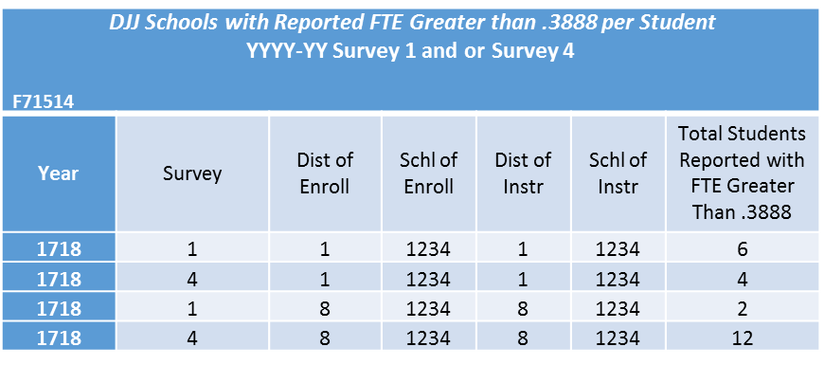
FTE Reports
NEW Reported FTE Reports
F71514 (Surveys 1 and 4) – DOE generated district-level DJJ FTE Data Quality report ran throughout Survey 1 and 4.
Displays active DJJ schools with the total number of students reported in Survey 1 and or 4 with FTE greater than .3888.
Active DJJ schools with zero students reported in Survey 1 and or 4 with FTE greater than .3888 will not appear on this list.

Slide 12
FTE Reports
Recalibrated FTE Reports
DOE generated after state processing for Surveys 2, 3, and 4.
Recalibrated FTE reports and files are only available for a limited time. Districts should download ALL recalibrated FTE files made available after each survey.
Preliminary FTE Recalibrated reports will be run following the close of Survey 2, 3, and 4 state processing and should be downloaded and reviewed by districts to make any necessary data reporting corrections by the end of the Survey amendment window.
District-level Summary Reports
F71344 and F71345 (data file F71354) – Recalibrated version of the F05107 and F05108 reports.
F71451 – This report is divided up by district schools and will show the amount of FTE reported by the school, the amount of FTE recalibrated for the school, and the count of students reported by the school. The amount of FTE reported, FTE recalibrated, and total students shared by another district or school is also listed.

Slide 13
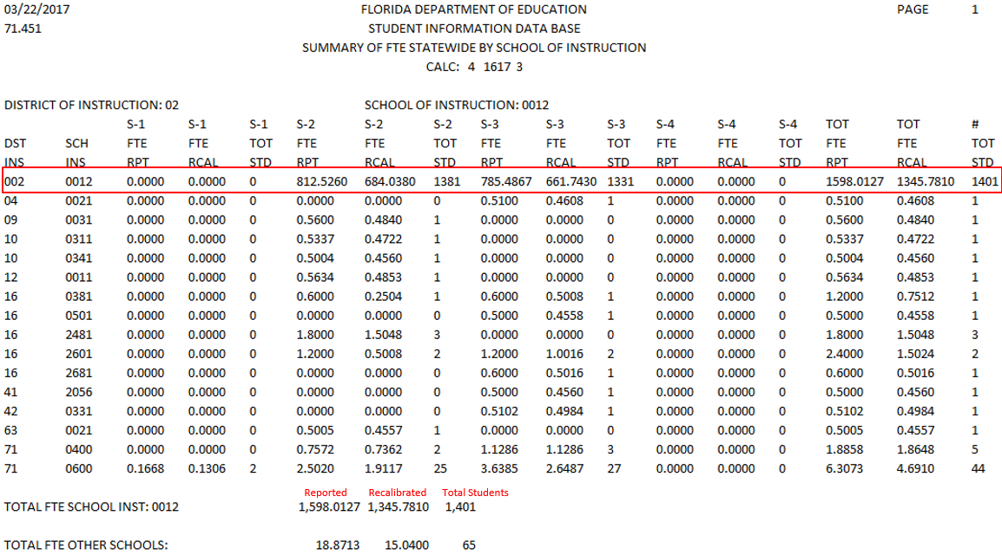
Example of Report F71451

Slide 14
FTE Reports
Recalibrated FTE Reports
Student-level Reports
F71347 – “Singles Report” - Individual student recalibrated FTE based on a single Student ID. Student ID only reported by one district. FTE is not shared.
F71372 – “Multiples Report” - Individual student recalibrated FTE based on Student ID; reported by multiple districts. FTE is shared.
F71373 – “Student Demo Report” - Individual student recalibrated FTE based on student demographics; reported by multiple districts. FTE is shared.
F71389 – “DJJ Report” - Individual student recalibrated FTE for DJJ students reported within a single district.
F71423 – “Claims Report” - Individual student recalibrated FTE for Claims Submitted based on Student Demographic Match.
F71503 – “McKay Report” – Individual student recalibrated FTE for students reported with McKay Enrollment.
F71452 – “All District Data” - Individual student recalibrated FTE reported by the district broken out into 4 separate files by MSID School Type.
F71494 – “Student Summary Report” – Summary of individual student FTE by Survey. Student-level version of the F71451.
This report shows the amount of FTE reported and recalibrated for the student by school. The amount of FTE reported and recalibrated by another district or school sharing the student is also listed.

Slide 15
Example of Report F71494

Slide 16
Data Quality Issues and Reminders
Postsecondary Career Instruction Provided at a Technical Center Located in the Same School District:
Dual Enrollment Indicator = C
School of Enrollment = Secondary School
School of Instruction = Technical Center
Students who meet the membership requirement to be reported in the survey, but do not meet the attendance requirement to receive funding, must be reported with zero FTE and FEFP Program Number 999.
Students enrolled in virtual courses that were reported “In Progress” in Survey 2 and/or Survey 3, have until the Survey 4 final amendment date to successfully complete the course and be reported for funding.
Students not enrolled/reported in virtual courses that were reported “In Progress” in Survey 2 and/or Survey 3, have until the end of the regular 180-day school year to successfully complete the course and be reported for funding.
Virtual courses reported for hospital/homebound students are funded in the same manner as all other virtual courses; on successful completion basis.

Slide 17
Data Quality Issues and Reminders
A student reported in the same fiscal year, but with different Student Number Identifier, Florida may be incorrectly funded for the fiscal year. This may result in an audit finding for the student incorrectly receiving more than 1.0 FTE.
Student additional funding for early high school graduates is reported in Survey 5 of the year in which the student graduates. However, funding is provided in the following fiscal year.
The 24 credit hour standard diploma is the only diploma eligible for early graduate funding.
During the 3rd FEFP Calculation, student FTE is capped at 0.5 FTE. However, during the 4th FEFP Calculation, if a student is reported for funding in both Surveys 2 and 3, the student is capped at 1.0 FTE. For this reason, even though Survey 2 data are final, depending on which Survey has the most FTE, you may notice an increase or decrease in the Survey 2 recalibrated figures in Calc 4 compared to Calc 3. This is normal and expected.
Per the 2017-18 FTE General Instructions (Pg. 4) “The FTE for intersession and summer school courses is reported even though the FTE does not earn FEFP funds.”
Per the 2017-18 FTE General Instructions (Pg. 28) “The maximum combined FTE reported for Surveys 1 and 4 shall not exceed 0.3888 FTE per student.” A new DJJ FTE data quality report has been created.

Slide 18
Questions?
Contact:
Kenneth Dukes
Kenneth.Dukes@fldoe.org
(850) 245-9912
Tony Justice
Tony.Justice@fldoe.org
(850) 245-9072

